Slide 1
DBMS

Slide 2
File-based Definition
Program defines and manages it’s own data

Slide 3
Limitations of File-based Approach
Separation and isolation
Duplication
Program & data dependence
Fixed queries
Proliferation of application programs

Slide 4
History of Database Systems
First generation
Hierarchical model
Information Management System (IMS)
Network model
Conference on Data System Languages (CODASYL)
Data Base Task Group (DBTG)
Limitation
Complex program for simple query
Minimum data independence
No theoretical foundation
Second generation
Relational model
E. R. Codd
DB2, Oracle
Limitation
Limited data modeling
Third generation
Object-relational DBMS
Object-oriented DBMS

Slide 5
Database
Definition
A collection of self-describing and integrated data files
System catalog
Meta data
Data dictionary
Overhead data

Slide 6
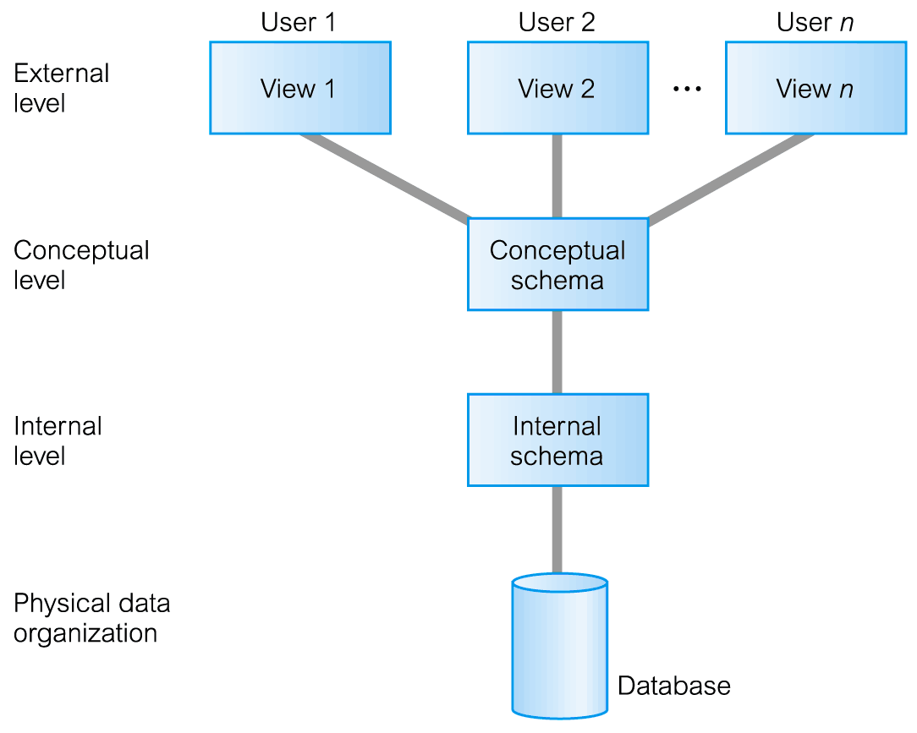
ANSI-SPARC Three-Level Architecture
We need to get familiarized with such organizations…
Very important
American National Standard Institute on System Planning and Requirement Committee

Slide 7
ANSI-SPARC Three-Level Architecture

Slide 8
ANSI-SPARC Three-Level Architecture
3-level Design intends to offer
More flexibility
and more usability
E.g, why we need a representative for DB class?
The same is true…
Divide and conquer
in system design

Slide 9
ANSI-SPARC Three-Level Architecture
External Level
Users’ view of the database.
Describes that part of database that is relevant to a particular user.
Conceptual Level
Community view of the database.
Describes what data is stored in database and relationships among the data.

Slide 10
Describes what is concerned by the users,
Which is usually part of logical schema…
E.g, in the student – course scenario.
Student manager wants to see student, while
Course manager wants to see course…
External Level
Users’ view of the database.
Describes that part of database that is relevant to a particular user.
Conceptual Level
Community view of the database.
Describes what data is stored in database and relationships among the data.

Slide 11
ANSI-SPARC Three-Level Architecture
Describes the overall situation of what data is like…
which is common to all users or applications in logical level …
E.g, in the student – course scenario.
The student, course, and student-course tables schema remains the same to all managers or users no matter what they want individually…
External Level
Users’ view of the database.
Describes that part of database that is relevant to a particular user.
Conceptual Level
Community view of the database.
Describes what data is stored in database and relationships among the data.

Slide 12
ANSI-SPARC Three-Level Architecture
Internal Level
Physical representation of the database on the computer.
Describes how the data is stored in the database.

Slide 13
ANSI-SPARC Three-Level Architecture
Describes how data is stored or represented in DB…
which is schema or description in physical level …
E.g, in the student – course scenario.
The student table is indexed with clustering …
while course, and student-course tables uses unique index,…
Internal Level
Physical representation of the database on the computer.
Describes how the data is stored in the database.

Slide 14
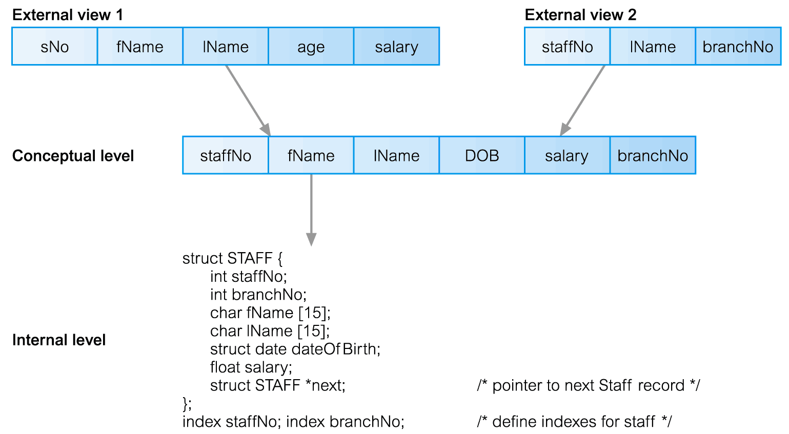
Differences between Three Levels of ANSI-SPARC Architecture
ANSI-SPARC Three-Level Architecture
Let’s see another scenario…

Slide 15
Differences between Three Levels of ANSI-SPARC Architecture
ANSI-SPARC Three-Level Architecture
Here, User1 wants to see the information about staff…
Staff No.
Staff name
Staff age
Staff salary
External view1 extracts them…

Slide 16
Differences between Three Levels of ANSI-SPARC Architecture
ANSI-SPARC Three-Level Architecture
Here, User2 wants to see the information about staff-branch relationship…
Which staff works in which branch…
External view2 extracts them…

Slide 17
Differences between Three Levels of ANSI-SPARC Architecture
We come to conceptual level and notice that it contains all the information needed and remains the same to all users…
Information about staff, and their branch No. …
Requires very careful design…

Slide 18
Differences between Three Levels of ANSI-SPARC Architecture
When we move on to internal level we notice
it talks a lot in physical structure, like pointers, indexes types applied, etc.
Description about how data is stored … while still notices that
it is only description also logically existence…

Slide 19
Database Management System Facility
Data definition language (DDL)
Data manipulation language (DML)
Structured query language (SQL)
Security system
Integrity system
Concurrency control system
Backup & recovery system
View mechanism

Slide 20
DBMS Environment
Hardware
Client-server architecture
Software
dbms, os, network, application
Data
Schema, subschema, table, attribute
People
Data administrator & database administrator
Database designer: logical & physical
Application programmer
End-user: naive & sophisticated
Procedure
Start, stop, log on, log off, back up, recovery

Slide 21
Data Base and DBMS
It is a collection of logically related data. Data base management system is a software (DBMS) which manages this data.
It is layer between programs and data
It makes possible for user to create , read, update and delete data.
It provides features for data like data retrieval,data integrity,data modification,data security

Slide 22
Advantages of DBMS
Reducing data redundancy: Being a single entity any change in it is reflected immediately. Because of this , there is no chance of encountering multiple data or duplicate data.
Sharing of Data: Users can share data based on correct autorization protocols, remote users can also simultaneously access and share the data.
Data Integrity: It mean data is accurate and consistent.
Data Security: Only authorized users are allowed to access the data.
Backup and recovery: DBMS takes care of backup and recovery. It also restores the database after a crash or system failure to its previous condition.
e.g SQL: Structured query language.

